Slide 1
Reference)
https://docs.cloudera.com/documentation/enterprise/6/latest/topics/installation.html
https://sungwookkang.com/1358
https://joonyon.tistory.com/129

Slide 2
서버 구성
3대의 VMWare를 이용한 구성
서버1: 4GB Memory + 32GB HDD
서버2, 서버3: 3GB Memory + 32GB HDD

Slide 3
리눅스 설정(CentOS7)
0. root 암호는 root
1. 호스트명 변경
# echo "server01.example.com" > /etc/hostname
NOTE. 각 호스트별로 server명을 변경
2. /etc/hosts 설정
192.168.58.101 server01.example.com server01
192.168.58.102 server02.example.com server02
192.168.58.103 server03.example.com server03
192.168.58.104 server04.example.com server04
192.168.58.105 server05.example.com server05

Slide 4
리눅스 설정(CentOS7)
3. IP 설정 : ifconfig –a 명령어에서 나오는 디바이스명 ex) ens33
# cd /etc/sysconfig/network-scripts/
# uuidgen ens33 >> ifcfg-ens33 # <- WMWare 복제로 리눅스를 설치시 기존의 UUID를 변경하기 위한 조치
# vi ifcfg-ens33
...
UUID=
IPADDR=
...
# systemctl restart network
4. 방화벽 중지
# systemctl status firewalld
# systemctl stop firewalld
# systemctl disable firewalld

Slide 5
리눅스 설정(CentOS7)
5. SELinux 기능 제거
# setenforce 0
# vi /etc/selinux/config
SELINUX=disabled
6. ssh
[root@server01.example.com ~]# ssh-keygen -t rsa
[root@server02.example.com ~]# ssh-keygen -t rsa
[root@server03.example.com ~]# ssh-keygen -t rsa
# ssh-copy-id -i ~/.ssh/id_rsa.pub root@server01.example.com
# ssh-copy-id -i ~/.ssh/id_rsa.pub root@server02.example.com
# ssh-copy-id -i ~/.ssh/id_rsa.pub root@server03.example.com

Slide 6
리눅스 설정(CentOS7)
7. NTP 활성화
# yum -y install ntp
# systemctl stop chronyd
# systemctl disable chronyd
# systemctl start ntpd
# systemctl enable ntpd
8. openjdk 업데이트 및 jdk-devel설치
# java -version
# rpm -qa|grep openjdk
# rpm -e java-1.7.0-openjdk-1.7.0.261-2.6.22.2.el7_8.x86_64
# rpm -e java-1.7.0-openjdk-headless-1.7.0.261-2.6.22.2.el7_8.x86_64
# yum -y install java-1.8.0-openjdk.x86_64
# yum -y install yum install java-1.8.0-openjdk-devel.x86_64
# java -version
# rpm -qa|grep openjdk
# (export JAVA_HOME=/usr/lib/jvm/java-1.8.0-openjdk)

Slide 7
MariaDB 설치 및 설정)
1. DB 설치
(in server01)
# yum -y install mariadb-server
# vi /etc/my.cnf
>>>>>>>>>>>>>>>>>>>>>>>>>>>>>>>>>>
[mysqld]
datadir=/var/lib/mysql
socket=/var/lib/mysql/mysql.sock
transaction-isolation = READ-COMMITTED
# Disabling symbolic-links is recommended to prevent assorted security risks;
# to do so, uncomment this line:
symbolic-links = 0
# Settings user and group are ignored when systemd is used.
# If you need to run mysqld under a different user or group,
# customize your systemd unit file for mariadb according to the
# instructions in http://fedoraproject.org/wiki/Systemd
key_buffer = 32M
# (deprecated) key_buffer_size = 32M
max_allowed_packet = 32M
thread_stack = 256K
thread_cache_size = 64
query_cache_limit = 8M
query_cache_size = 64M
query_cache_type = 1
max_connections = 550
#expire_logs_days = 10
#max_binlog_size = 100M
#log_bin should be on a disk with enough free space.
#Replace '/var/lib/mysql/mysql_binary_log' with an appropriate path for your
#system and chown the specified folder to the mysql user.
log_bin=/var/lib/mysql/mysql_binary_log
#In later versions of MariaDB, if you enable the binary log and do not set
#a server_id, MariaDB will not start. The server_id must be unique within
#the replicating group.
server_id=1
binlog_format = mixed
read_buffer_size = 2M
read_rnd_buffer_size = 16M
sort_buffer_size = 8M
join_buffer_size = 8M
# InnoDB settings
innodb_file_per_table = 1
innodb_flush_log_at_trx_commit = 2
innodb_log_buffer_size = 64M
innodb_buffer_pool_size = 4G
innodb_thread_concurrency = 8
innodb_flush_method = O_DIRECT
innodb_log_file_size = 512M
[mysqld_safe]
log-error=/var/log/mariadb/mariadb.log
pid-file=/var/run/mariadb/mariadb.pid
#
# include all files from the config directory
#
!includedir /etc/my.cnf.d
<<<<<<<<<<<<<<<<<<<<<<<<<<<<<<<<<<

Slide 8
MariaDB 설치 및 설정)
# systemctl start mariadb
# systemctl enable mariadb
(root 패스워드 및 기타 보안 설정)
# /usr/bin/mysql_secure_installation
NOTE. 일단 패스워드는 계정과 동일하게...
Set root password? [Y/n] y
Remove anonymous users? [Y/n] y
Disallow root login remotely? [Y/n] n
Remove test database and access to it? [Y/n] y
Reload privilege tables now? [Y/n] y

Slide 9
MariaDB 설치 및 설정)
# mysql -u root -p
Enter password: [암호입력]
NOTE. default 계정: https://docs.cloudera.com/documentation/enterprise/6/latest/topics/install_cm_mariadb.html
MariaDB [(none)]> create database scm DEFAULT CHARACTER SET utf8 DEFAULT COLLATE utf8_general_ci;
MariaDB [(none)]> create database metastore DEFAULT CHARACTER SET utf8 DEFAULT COLLATE utf8_general_ci;
MariaDB [(none)]> create database hue DEFAULT CHARACTER SET utf8 DEFAULT COLLATE utf8_general_ci;
MariaDB [(none)]> create database rman DEFAULT CHARACTER SET utf8 DEFAULT COLLATE utf8_general_ci;
MariaDB [(none)]> grant all privileges on scm.* to 'scm'@'%' identified by 'scm';
MariaDB [(none)]> grant all privileges on metastore.* to 'hive'@'%' identified by 'hive';
MariaDB [(none)]> grant all privileges on hue.* to 'hue'@'%' identified by 'hue';
MariaDB [(none)]> grant all privileges on rman.* to 'rman'@'%' identified by 'rman';
MariaDB [(none)]> flush privileges;
MariaDB [(none)]> exit

Slide 10
MariaDB 설치 및 설정)
3. mariadb를 위한 JDBC 드라이버 설치
(in all hosts)
# ls /usr/share/java/my*
# wget https://dev.mysql.com/get/Downloads/Connector-J/mysql-connector-java-5.1.46.tar.gz
# tar zxvf mysql-connector-java-5.1.46.tar.gz
# cd mysql-connector-java-5.1.46/
# cp -p mysql-connector-java-5.1.46.jar /usr/share/java/mysql-connector-java.jar
NOTE. yum으로 설치하지 말것 (yum으로 mysql-connector-java 설치시 문서 작성 기준 5.1.26버전이 설치가 되는데 추후 Hive 설치시 문제가 발생!)

Slide 11
CM 다운로드 및 실행)
1. repo 다운로드
(in server01)
# cd /etc/yum.repos.d/
# wget https://archive.cloudera.com/cm6/6.3.1/redhat7/yum/cloudera-manager.repo
NOTE. 6.3.1 이후 버전은 인증 과정이 필요함.
2. 설치
# yum install cloudera-manager-daemons cloudera-manager-agent cloudera-manager-server
NOTE. VMWare로 설치시 여기까지 진행하고 shutdown한 이후 이미지 백업한 다음 이후 단계 진행(에러 발생시 여기서 부터 재진행)
3. Enable Auto-TLS
# JAVA_HOME=/usr/lib/jvm/java-1.8.0-openjdk /opt/cloudera/cm-agent/bin/certmanager setup --configure-services

Slide 12
CM 다운로드 및 실행)
4. 클라우드 매니저를 위한 DB설정 : 실행후 scm의 스키마에 테이블이 생성됨.
# /opt/cloudera/cm/schema/scm_prepare_database.sh mysql scm scm
(DB서버와 master가 다른 경우)
# (/opt/cloudera/cm/schema/scm_prepare_database.sh mysql -h server02.example.com --scm-host server01.example.com scm scm)
<실행예>
[root@server01 ~]# /opt/cloudera/cm/schema/scm_prepare_database.sh mysql scm scm
Enter SCM password:
JAVA_HOME=/usr/lib/jvm/java-openjdk
Verifying that we can write to /etc/cloudera-scm-server
Creating SCM configuration file in /etc/cloudera-scm-server
Executing: /usr/lib/jvm/java-openjdk/bin/java -cp /usr/share/java/mysql-connector-java.jar:/usr/share/java/oracle-connector-java.jar:/usr/share/java/postgresql-connector-java.jar:/opt/cloudera/cm/schema/../lib/* com.cloudera.enterprise.dbutil.DbCommandExecutor /etc/cloudera-scm-server/db.properties com.cloudera.cmf.db.
[ main] DbCommandExecutor INFO Successfully connected to database.
All done, your SCM database is configured correctly!
[root@server01 ~]#

Slide 13
CM 다운로드 및 실행)
4. 프로그램 시작
(in server01)
# systemctl start cloudera-scm-server
# tail -f /var/log/cloudera-scm-server/cloudera-scm-server.log

Slide 14
windows의 hosts파일에 등록 및 UI 실행)
C:\Windows\System32\drivers\etc\hosts
##### cloudera cluster #####
192.168.58.101 server01.example.com server01
192.168.58.102 server02.example.com server02
192.168.58.103 server03.example.com server03
192.168.58.104 server04.example.com server04
192.168.58.105 server05.example.com server05
웹브라우저에서 https://server01.example.com:7183/ (192.168.58.101:7183)
초기 계정과 암호는 admin / admin
NOTE. http:// 로 연결하면 안됨!

Slide 15
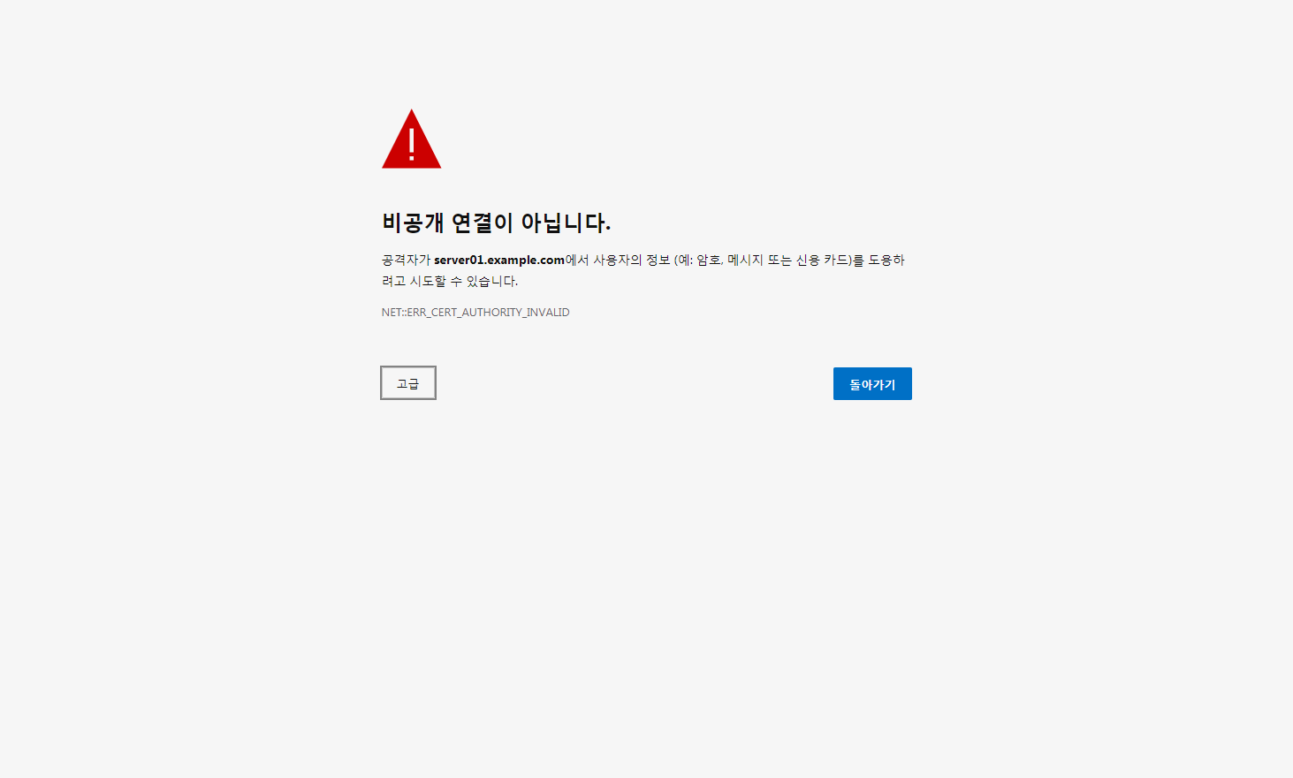

Slide 16
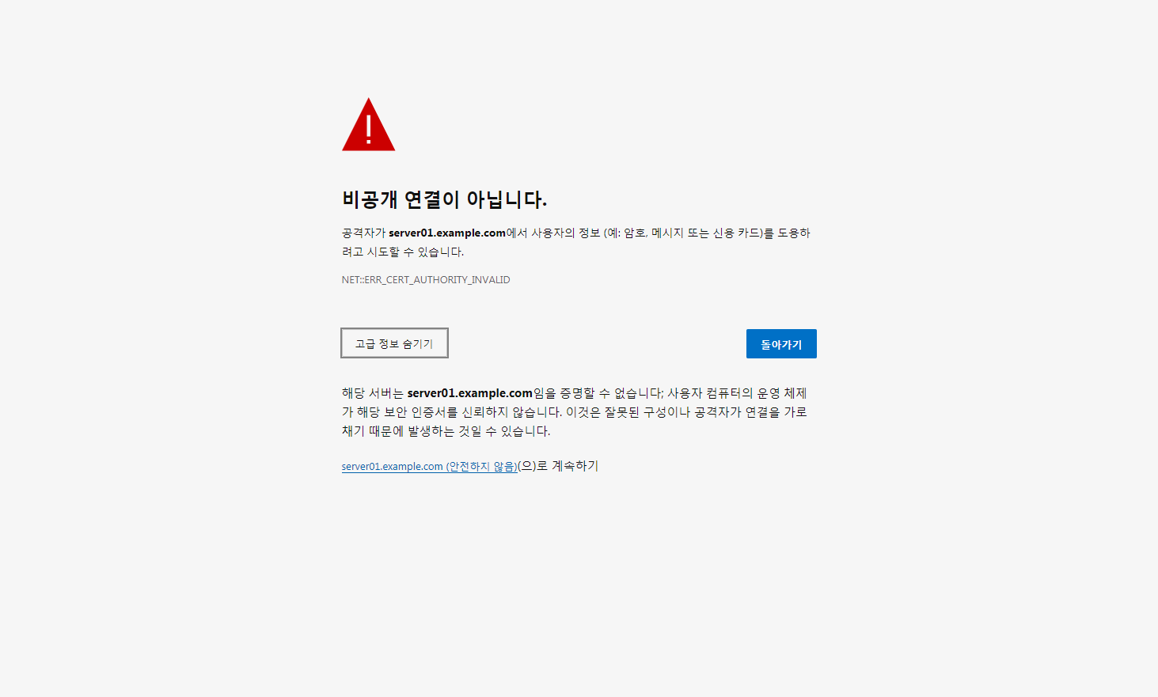

Slide 17
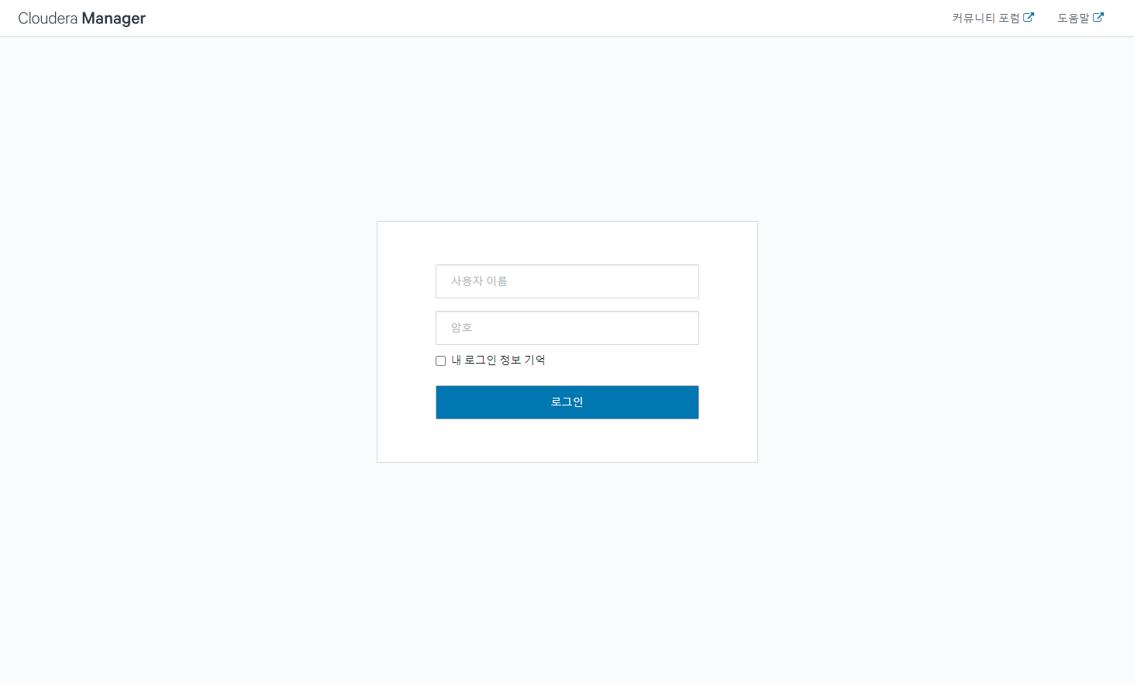
[Cloudera Enterprise 6.3.1 설치 화면 기준]
admin
admin

Slide 18
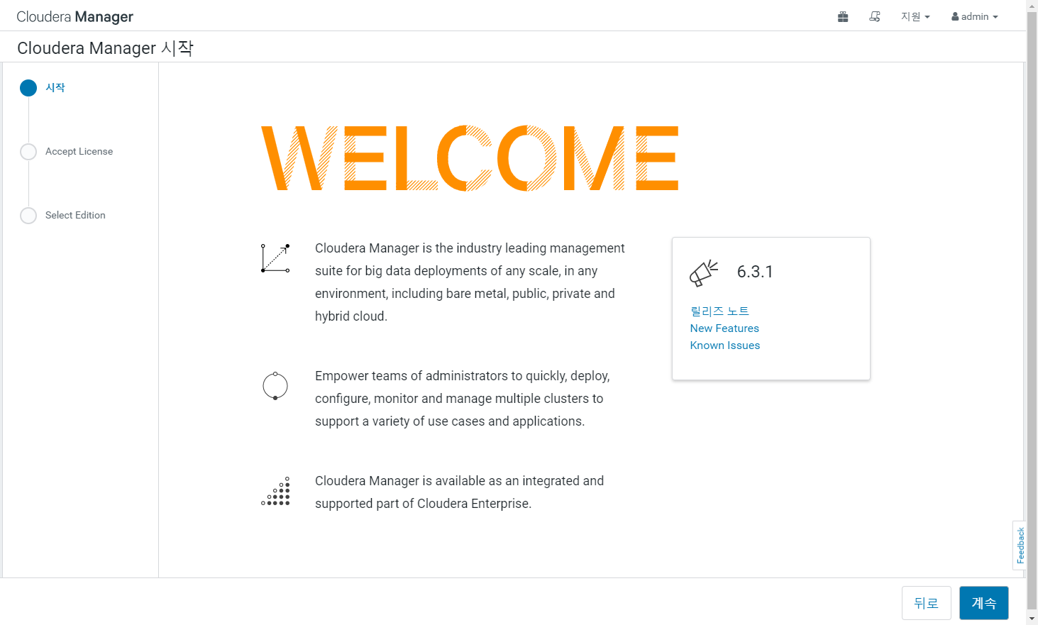

Slide 19
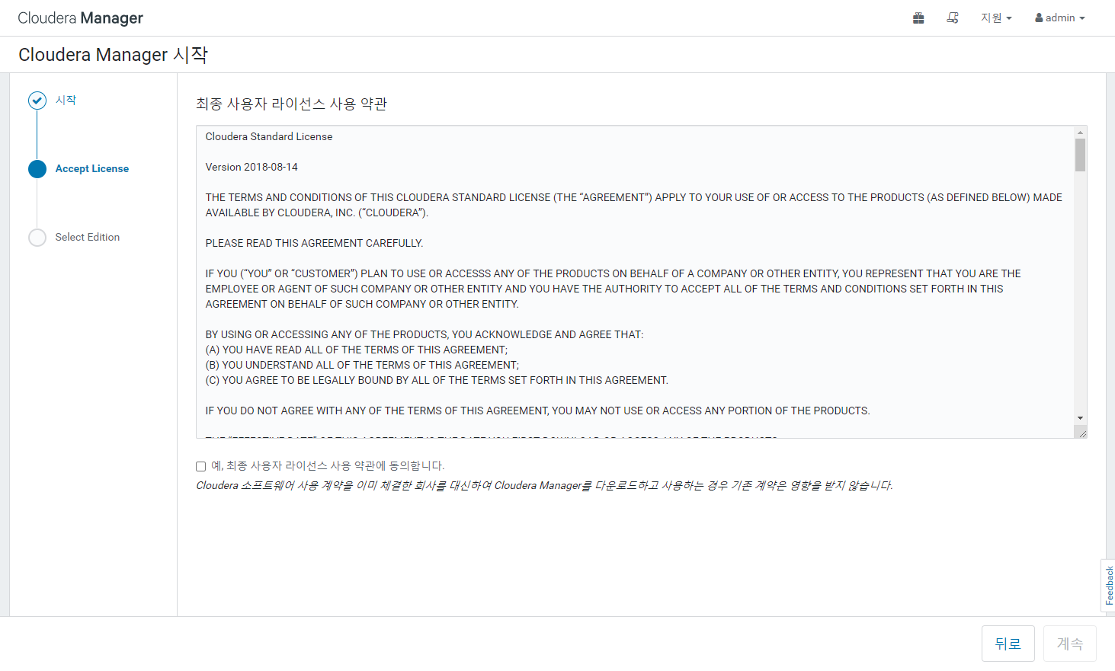
체크

Slide 20
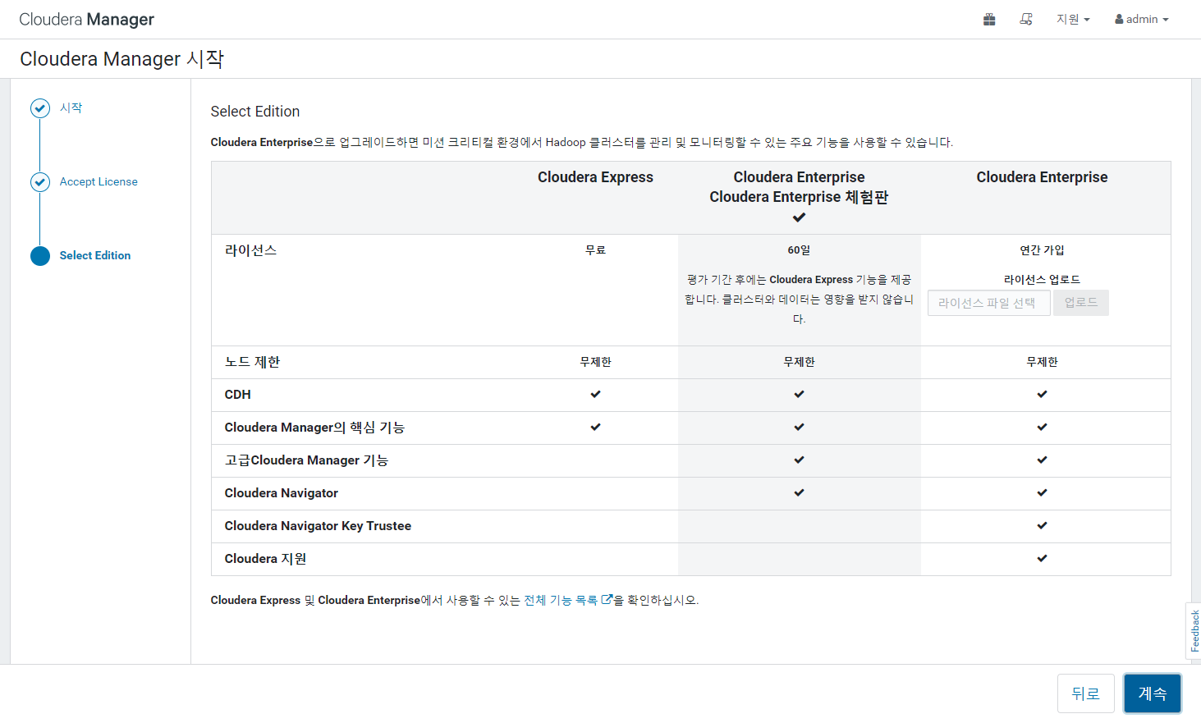

Slide 21
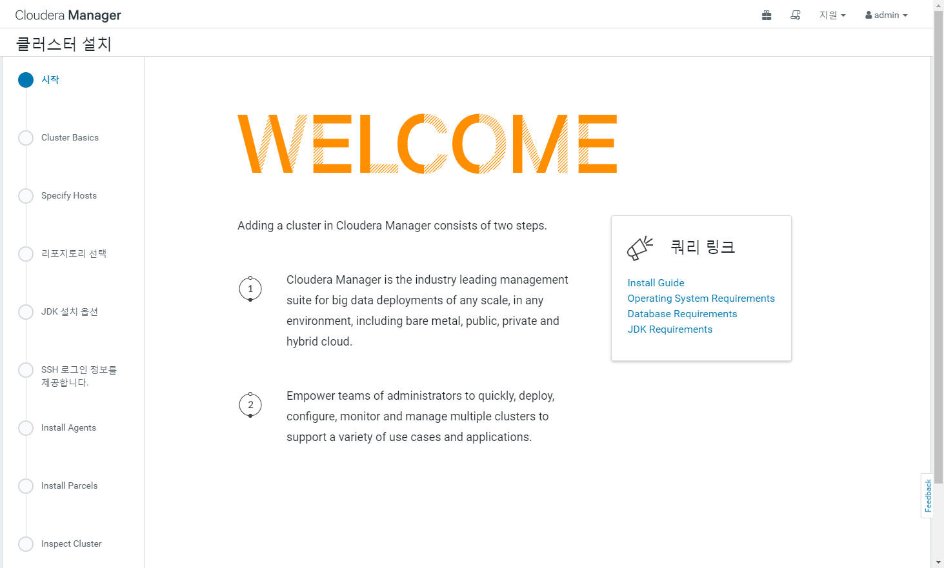

Slide 22
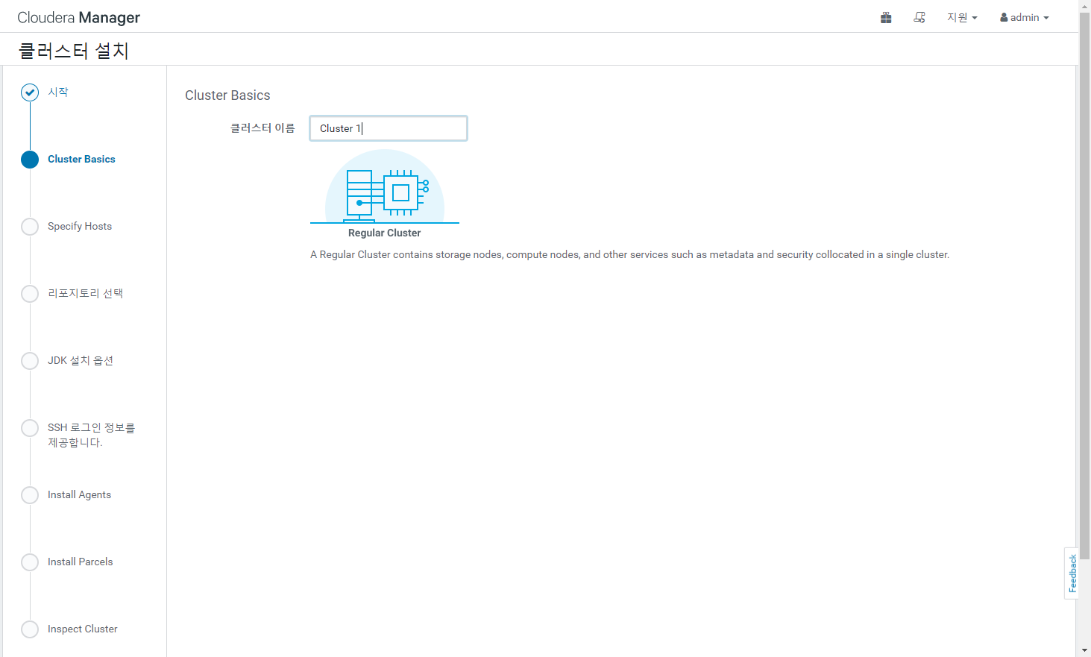
CM_Cluster

Slide 23
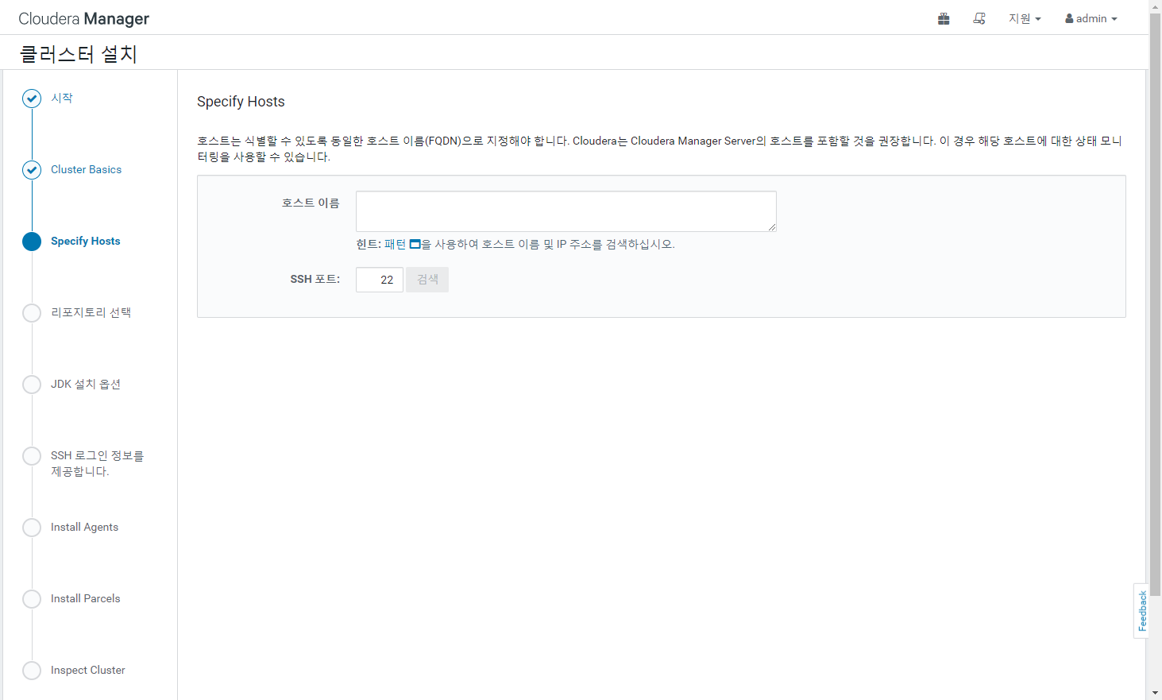
server01.example.com
server02.example.com
server03.example.com

Slide 24
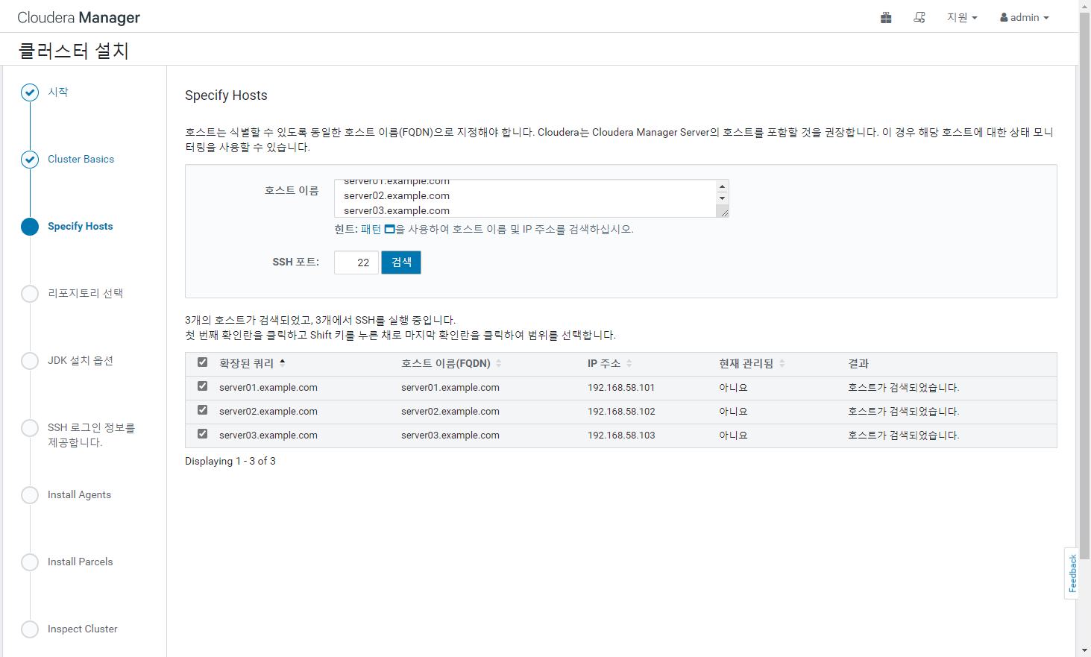

Slide 25
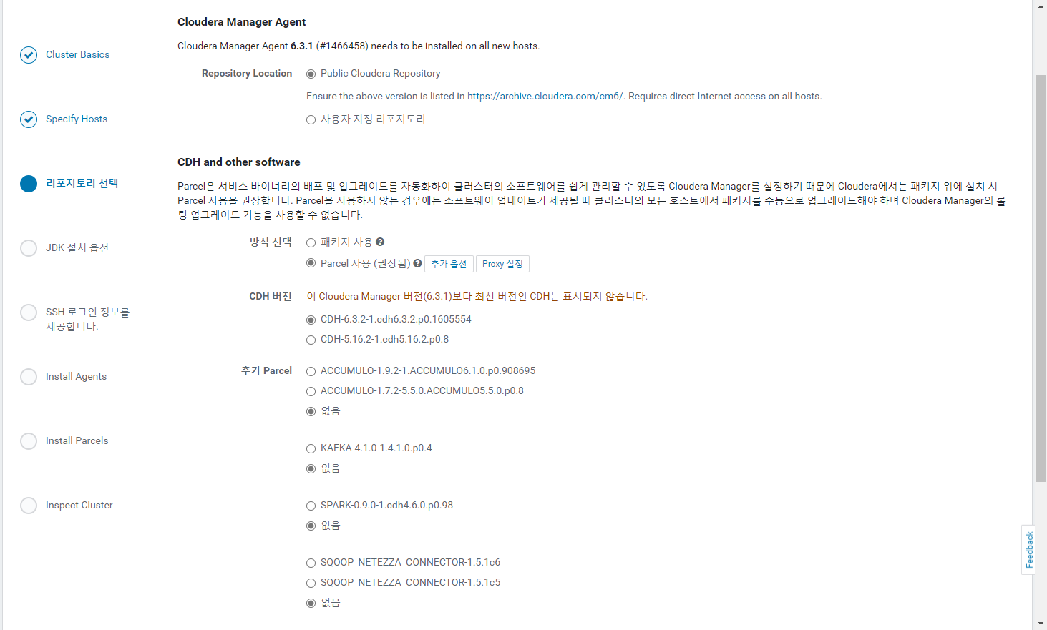

Slide 26
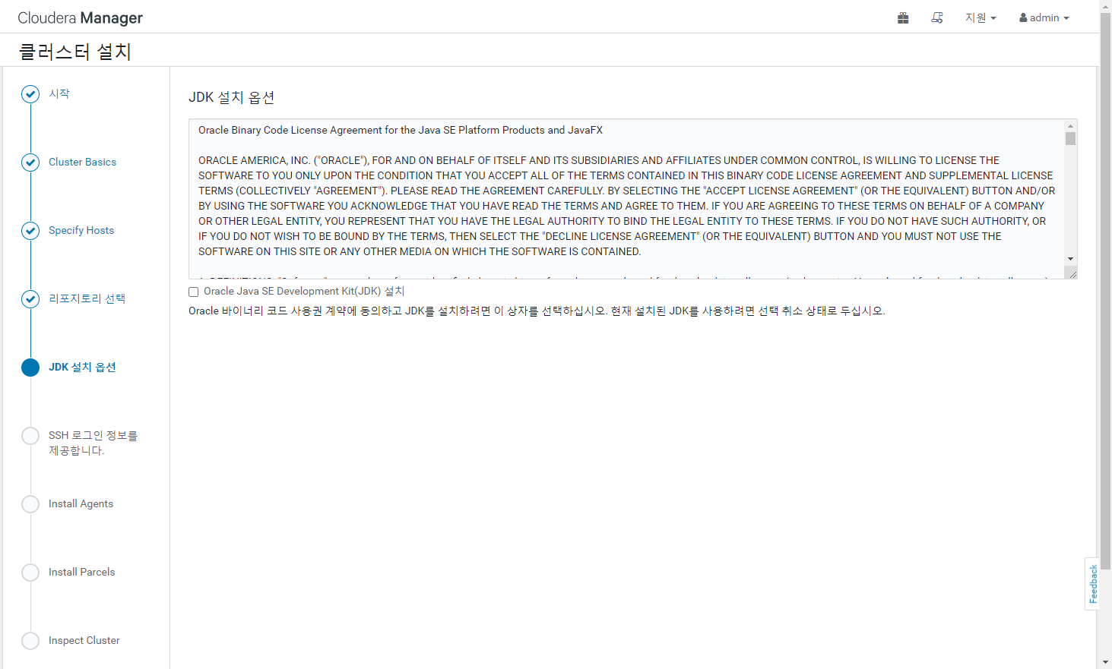
체크 하지 말것

Slide 27
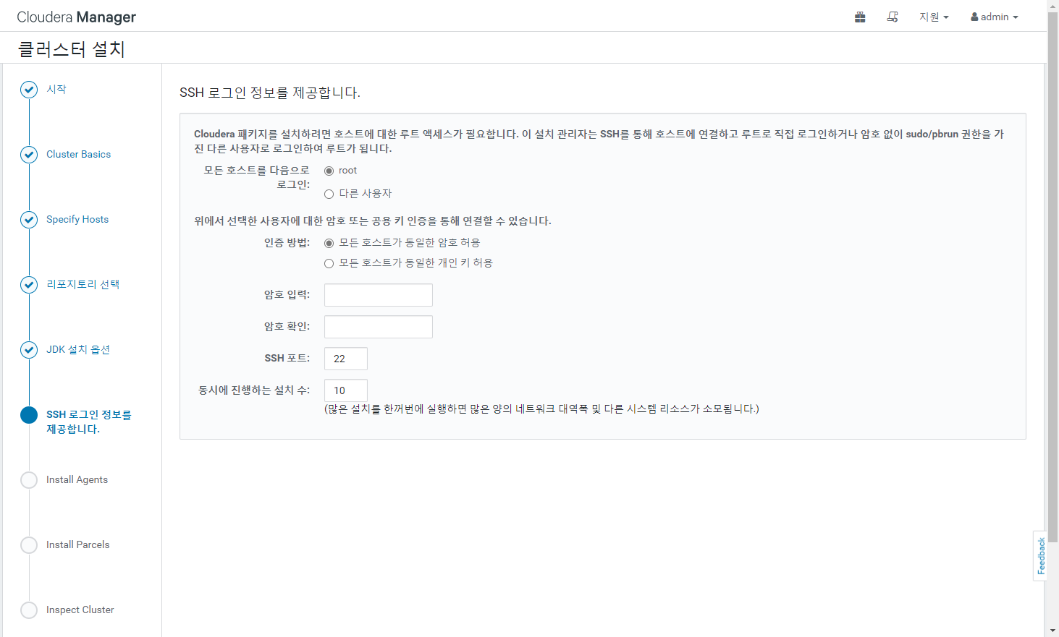
root
root

Slide 28
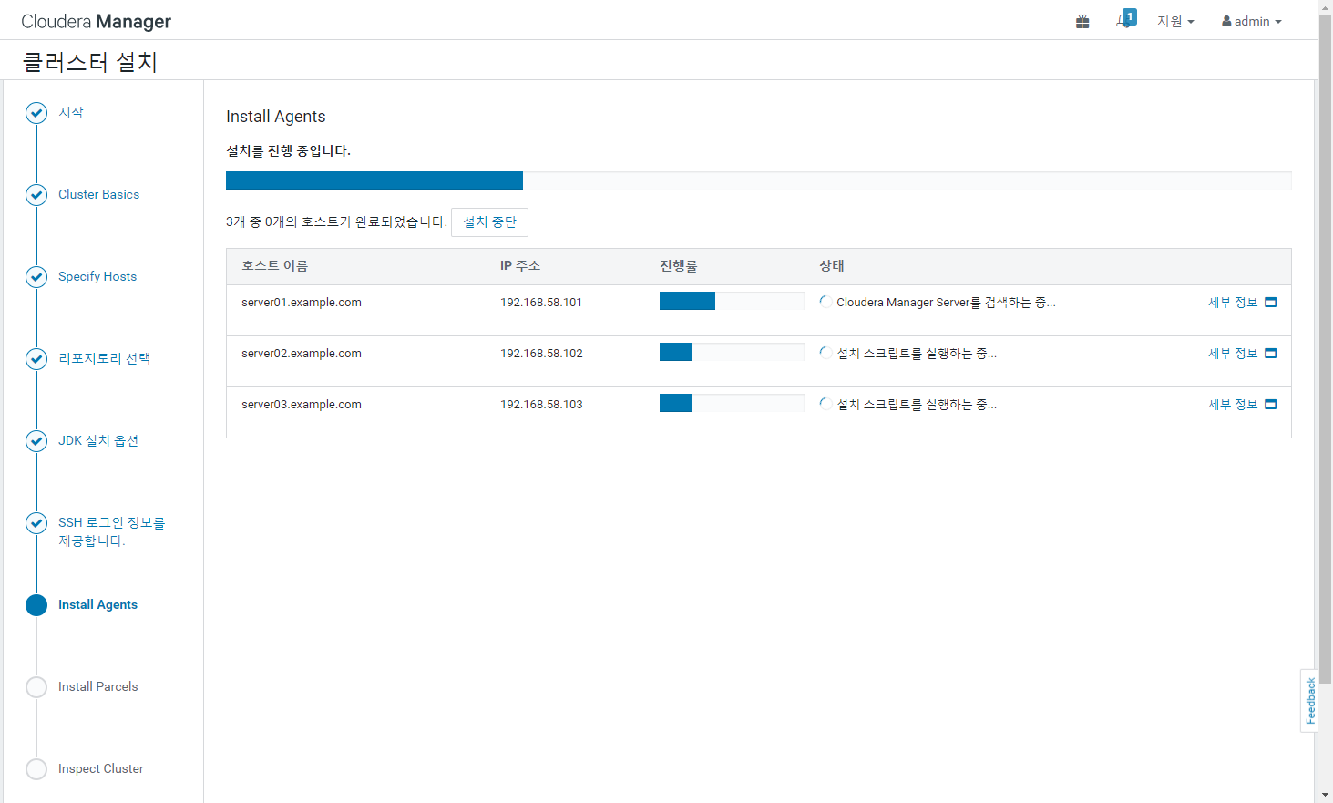

Slide 29
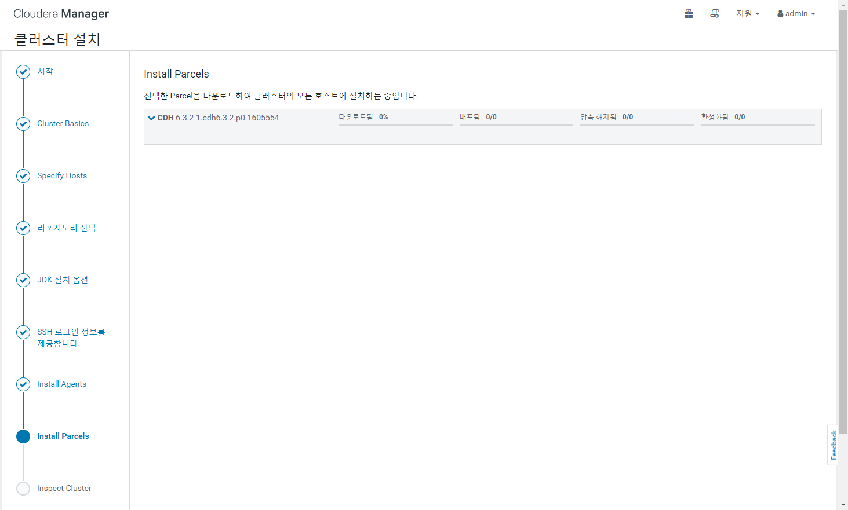

Slide 30
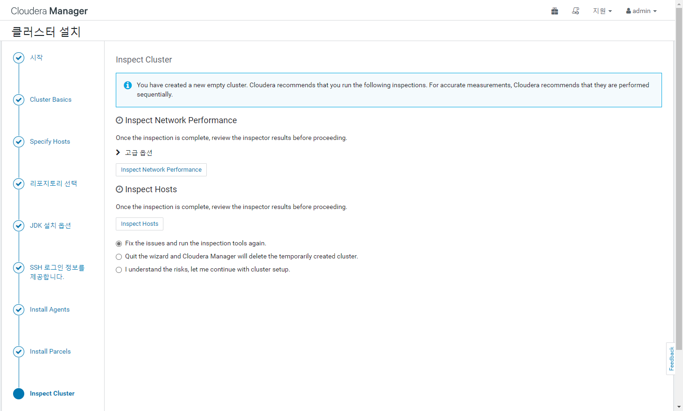

Slide 31
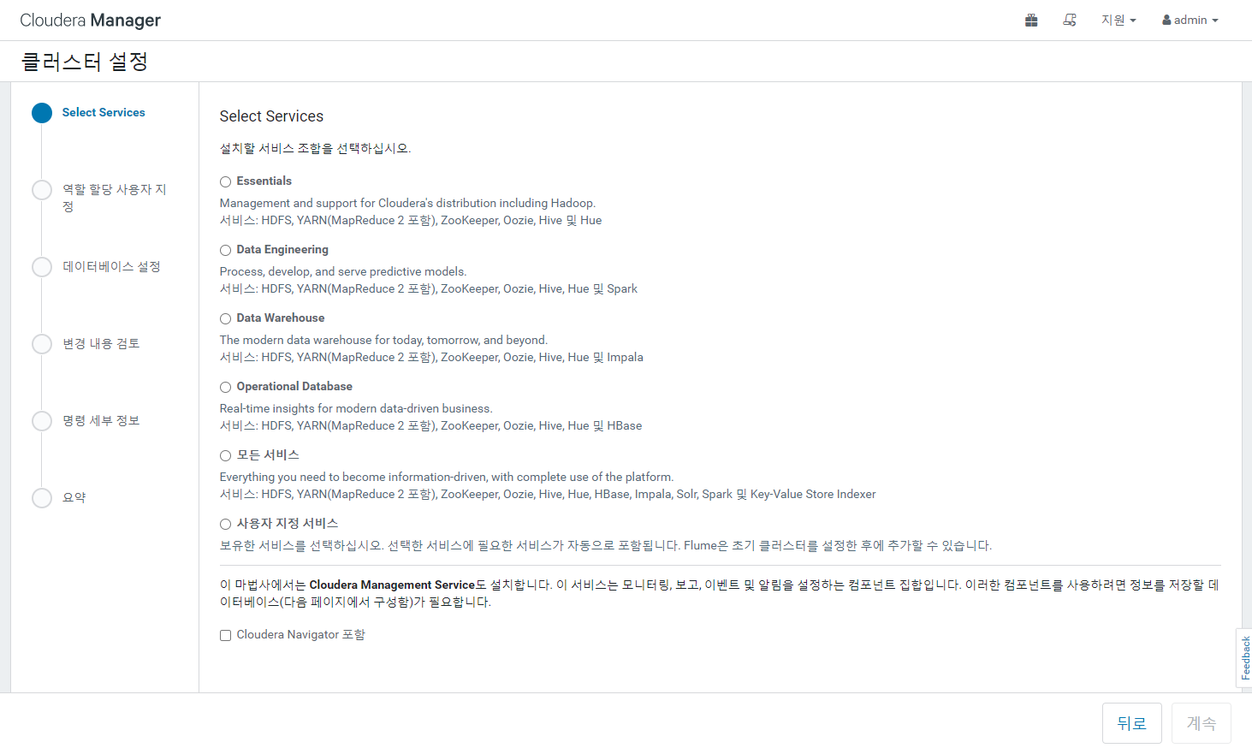

Slide 32
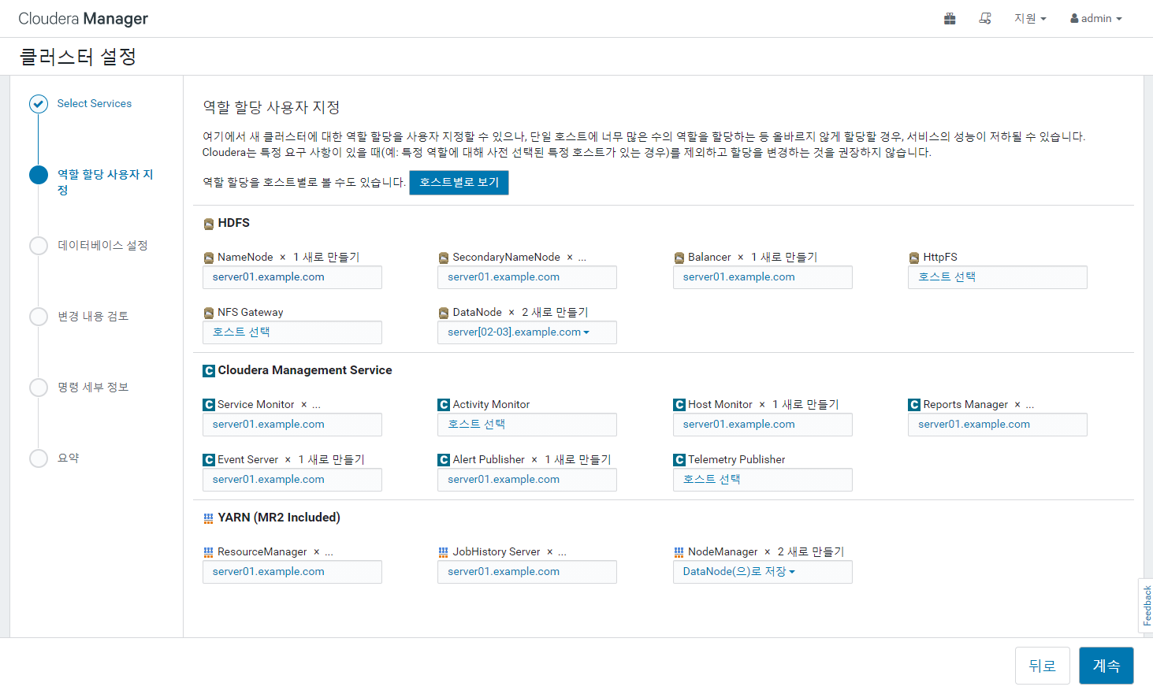

Slide 33
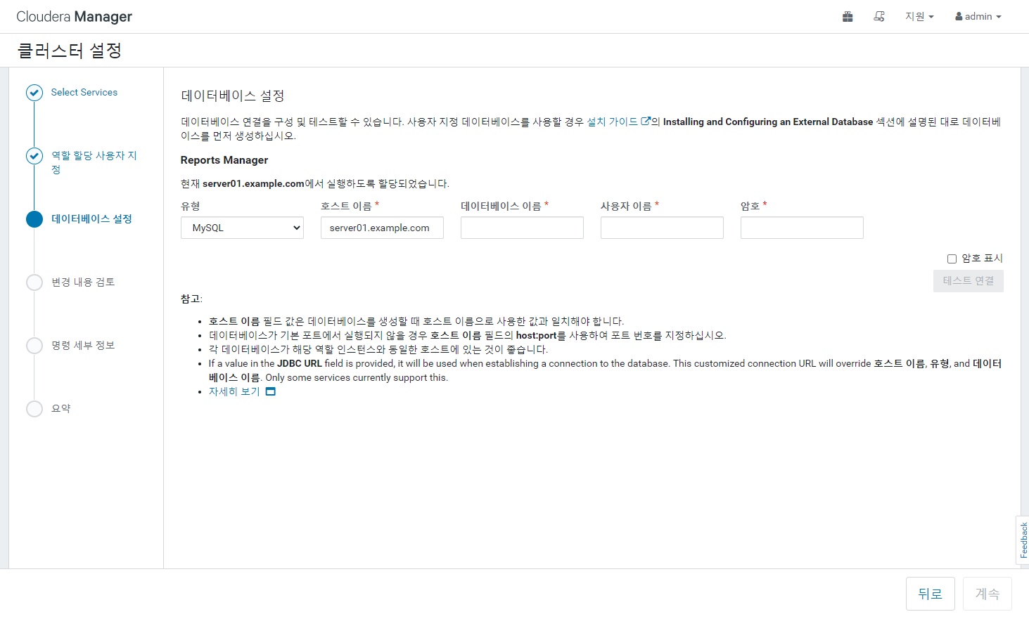
rman
rman
rman

Slide 34
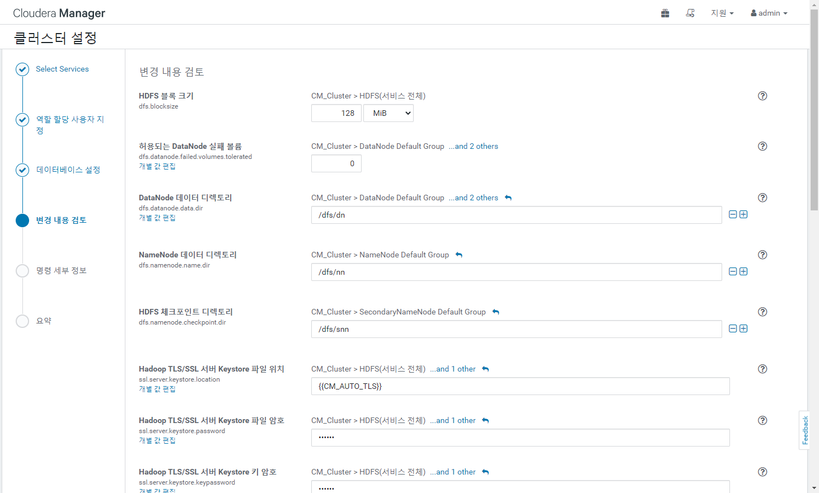

Slide 35
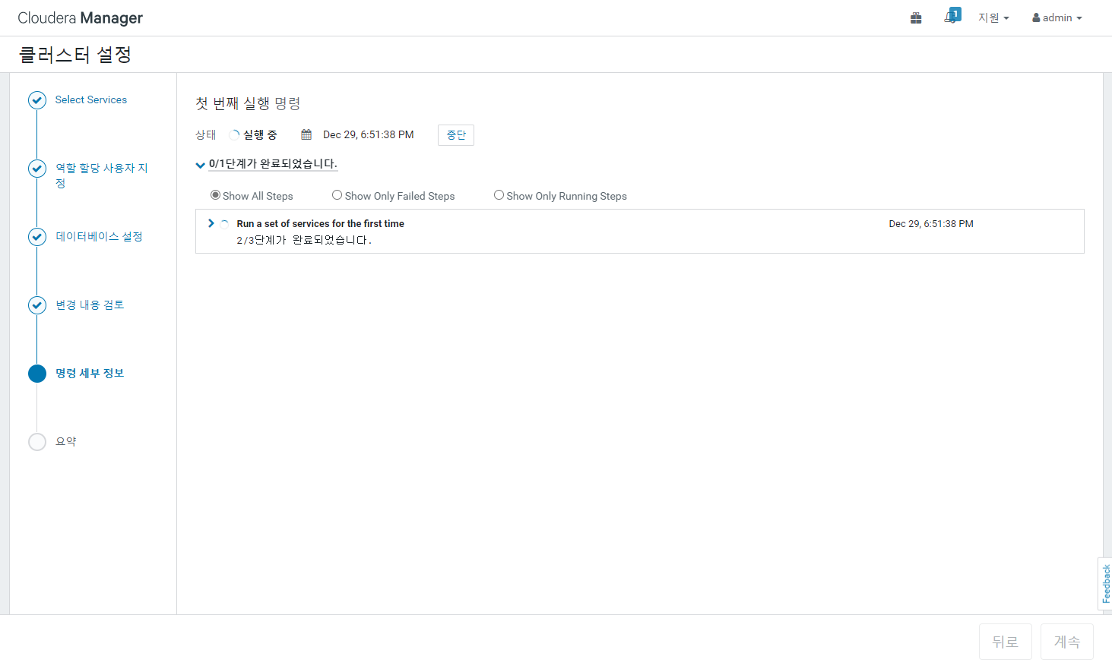

Slide 36
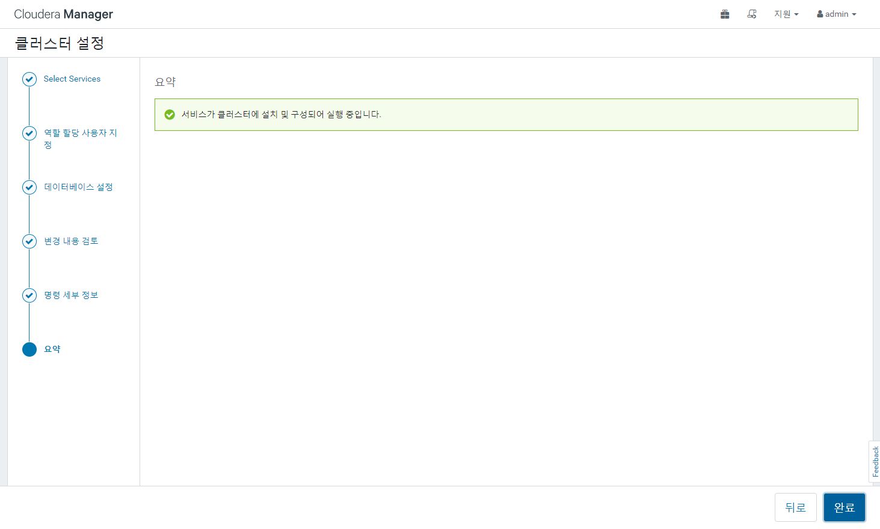

Slide 37
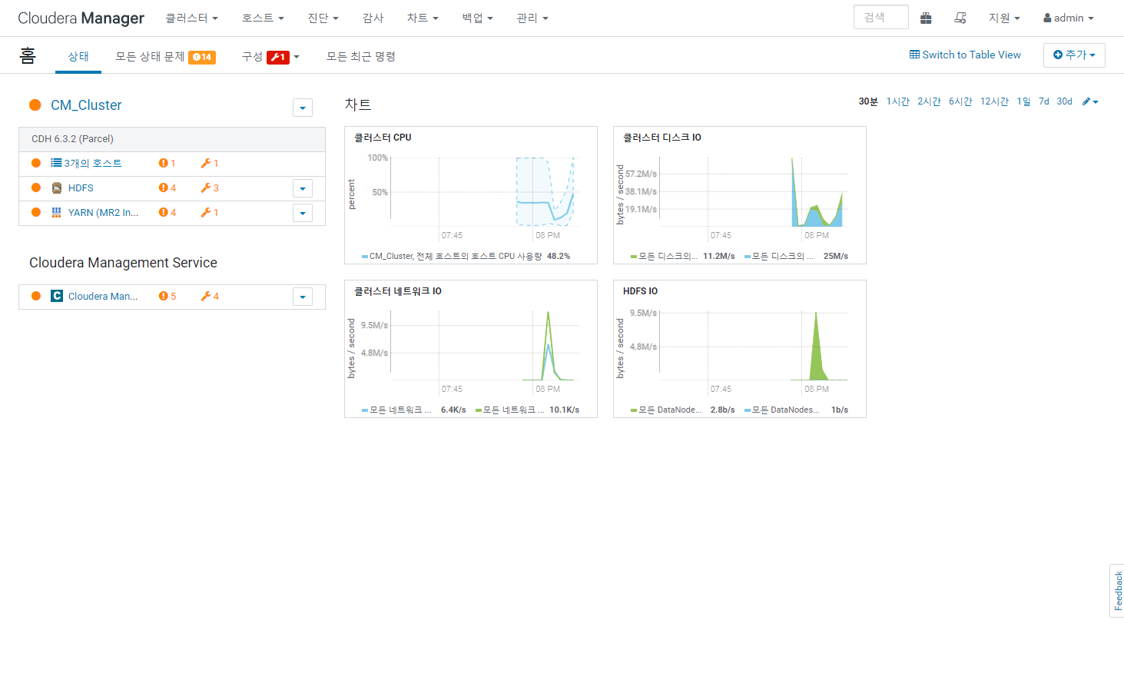

Slide 38
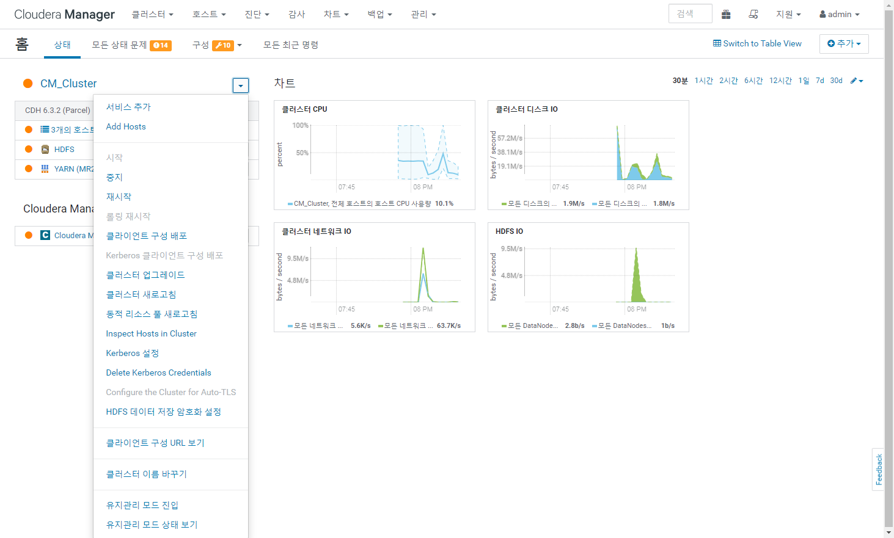

Slide 39
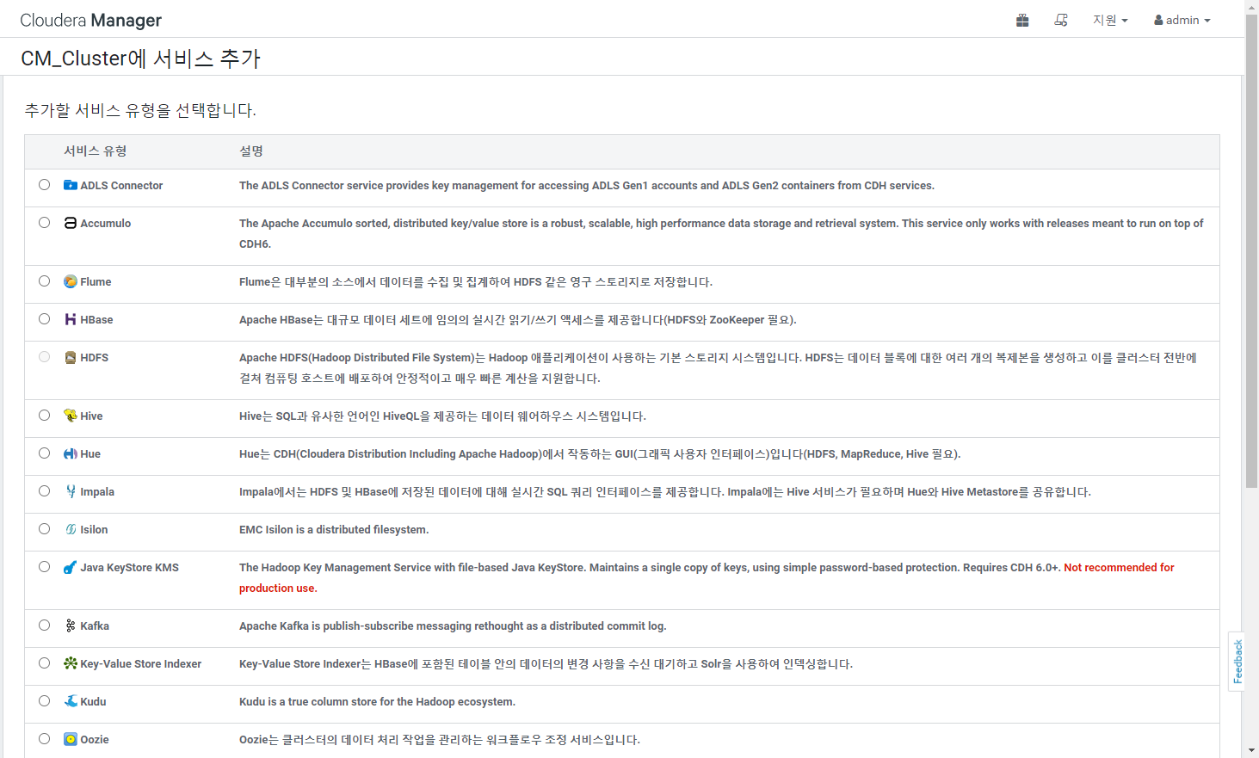

Slide 40
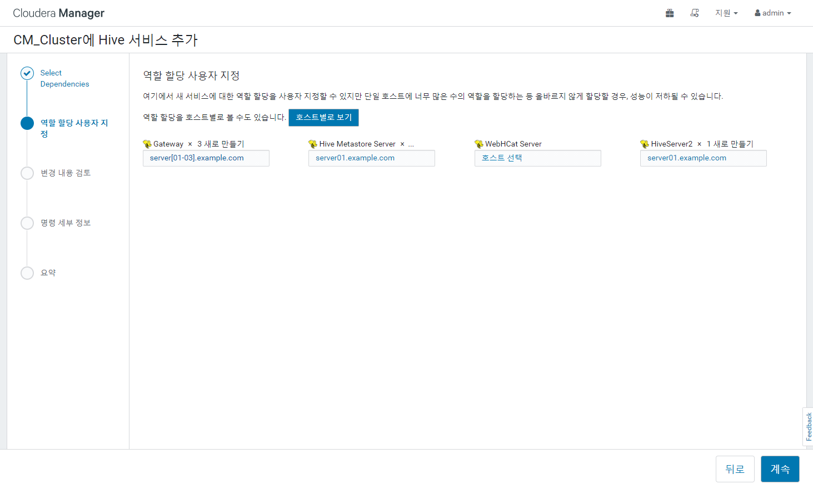
server01.example.com
server02.example.com

Slide 41
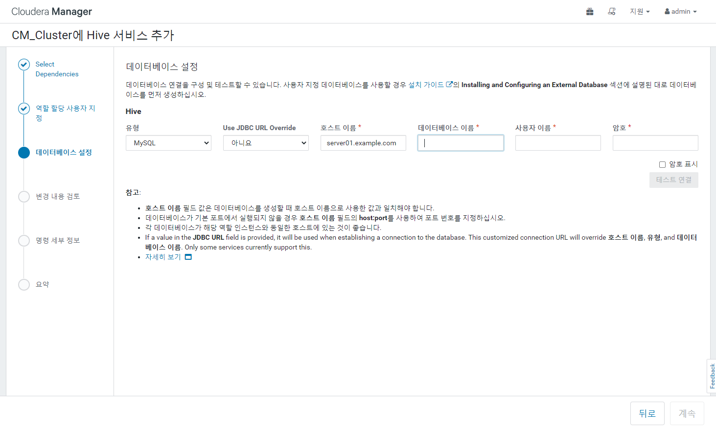
metastore
hive
hive

Slide 42
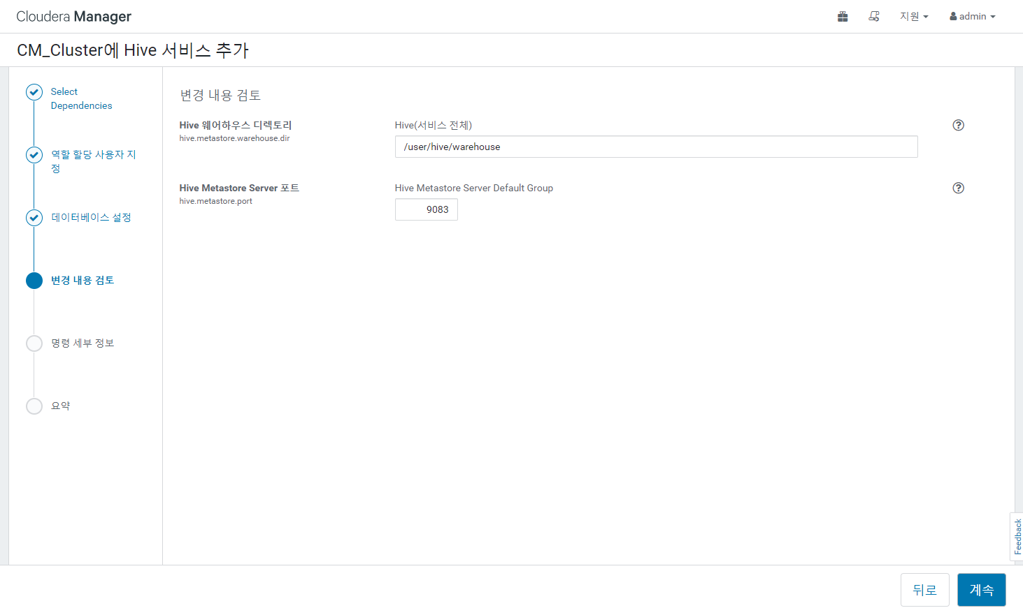

Slide 43
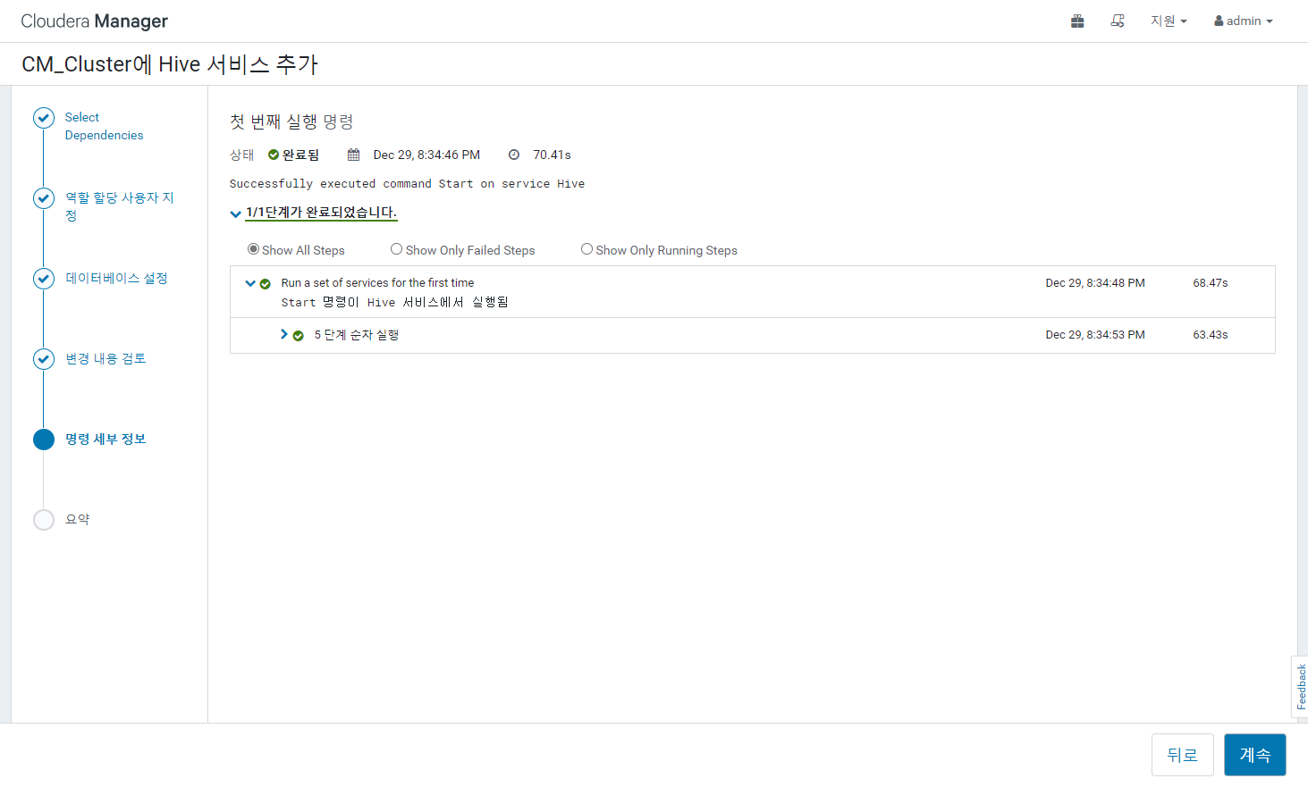

Slide 44
